Slide 1
Classification of TESS data for rocky exoplanets
Luis Andres García López
Facultad de Ciencias
Universidad Autónoma de Baja California (UABC)
Ensenada, Baja California
Email: luis.andres.garcia.lopez@uabc.edu.mx

Slide 2

Exploring New Worlds
There are several methods used to detect exoplanets, including the transit and radial velocity methods. Both methods involve detecting changes in the brightness or motion of a star, respectively, as a planet passes in front of it. These techniques have led to the discovery of thousands of exoplanets in our galaxy.

Slide 3
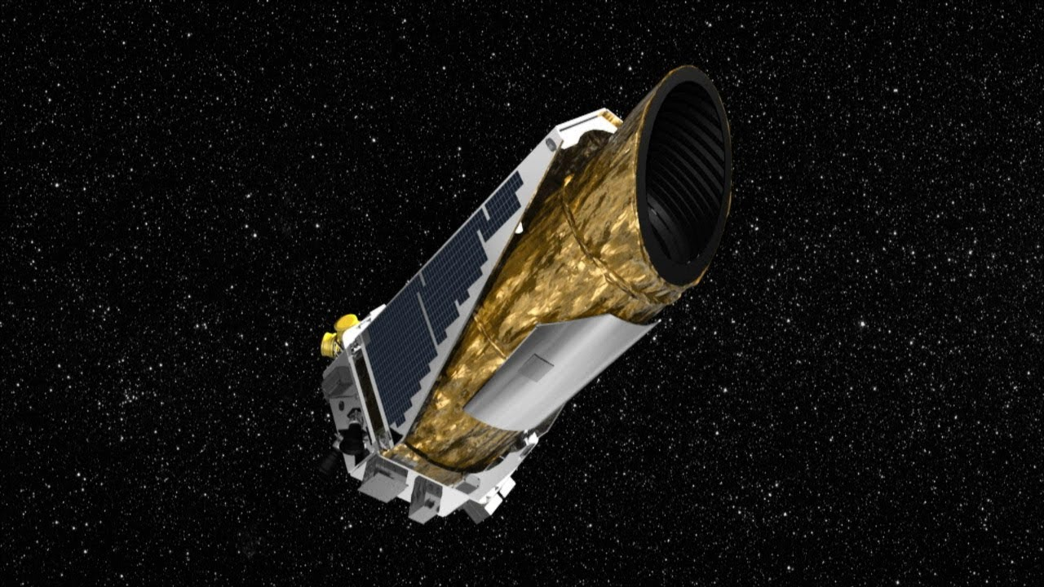
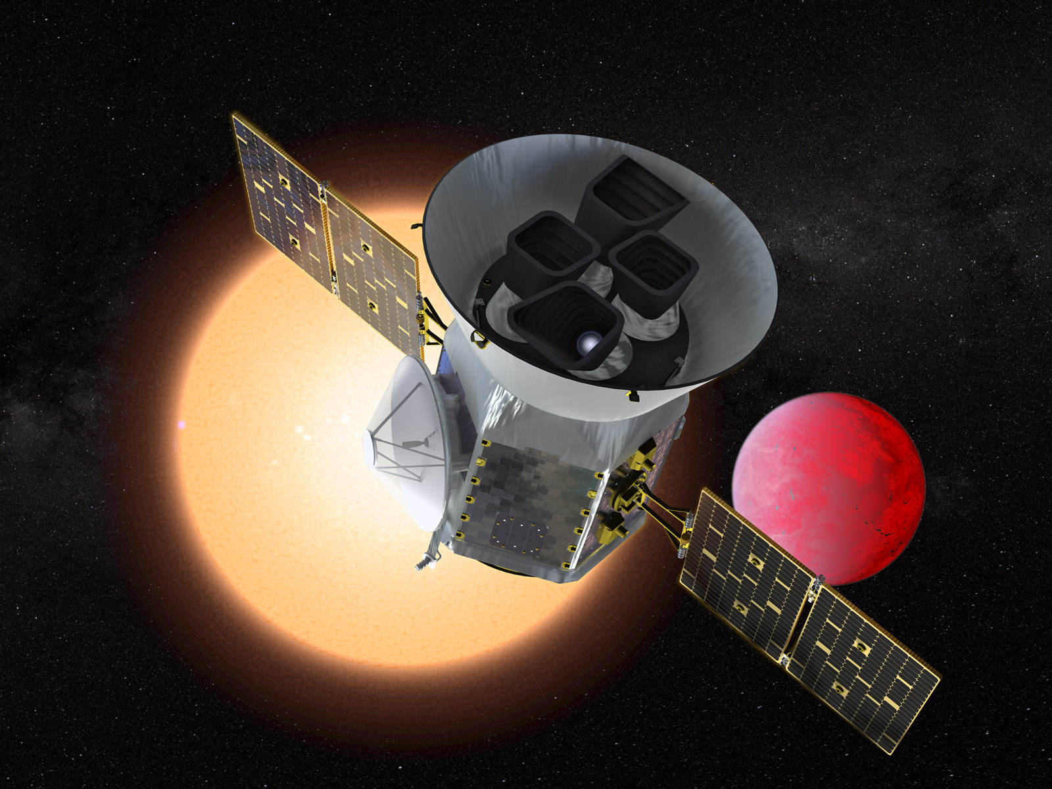
TESS Mission
A NASA mission that has as its main objective to search for planets in transit around stars close to our solar system.
Kepler Telescope
Tess telescope
TESS. (s. f.). Mission Overview. https://tess.mit.edu/science/

Slide 4
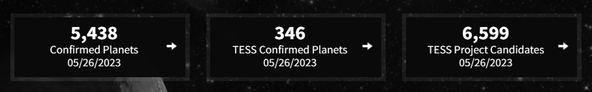
Data Mining for Exoplanet Classification
These techniques can help astronomers classify exoplanets based on their attributes, such as size, mass, and atmospheric composition. This can aid in the search for potentially habitable exoplanets.

Slide 5
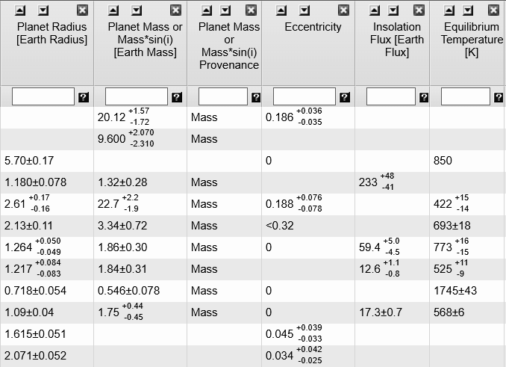
Preprocessing
The selected data from the TESS database were filtered as suggested in article [1], aiming to have a solid comparison base like Earth using ESI classification scheme.
[1]Schulze-Makuch, D., Méndez, A., Fairén, A. G., von Paris, P., Turse, C., Boyer, G., … Irwin, L. N. (2011). A Two-Tiered Approach to Assessing the Habitability of Exoplanets. Astrobiology, 11(10), 1041–1052. doi:10.1089/ast.2010.0592

Slide 6
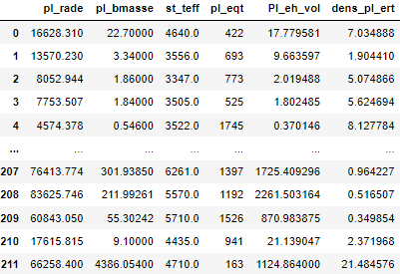
Data reduction
Due to the nature of the data being handled, there were initially missing values, which were removed along with the unused data. Additionally, noise reduction has been performed regarding error margins in certain values

Slide 7
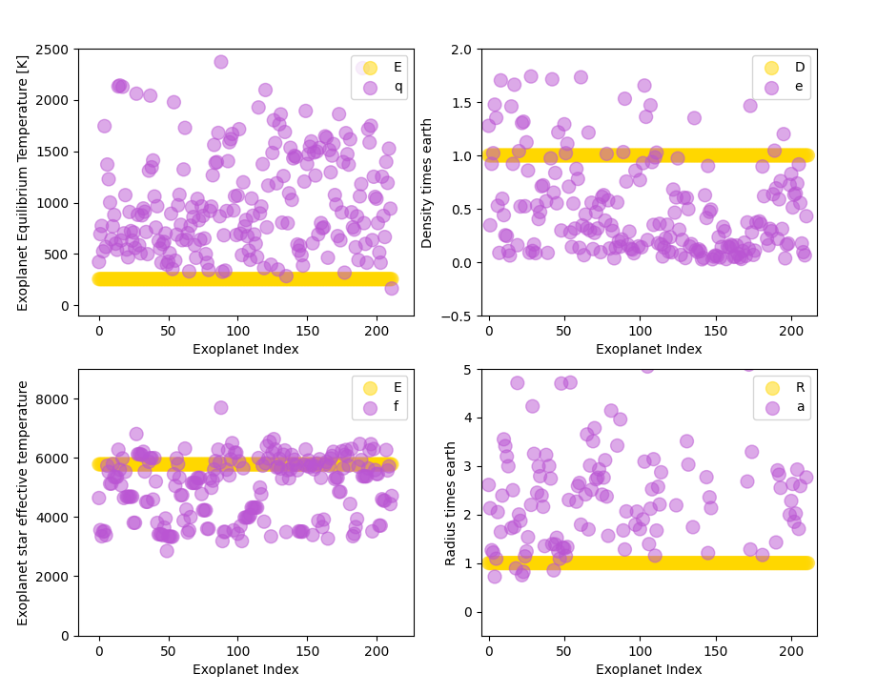
experimentation

Slide 8
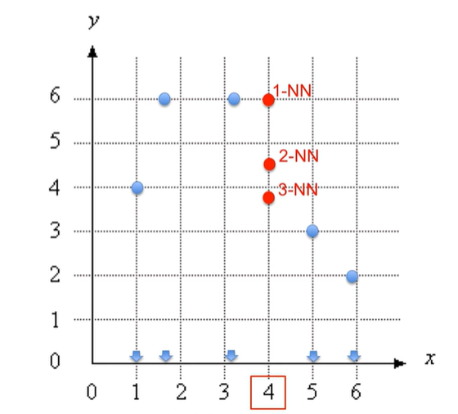
K-NeighborsRegressor
The objective of the KNeighborsRegressor algorithm is to find the relationship between the input features and the target values, and use this relationship to make predictions on new data.

Slide 9
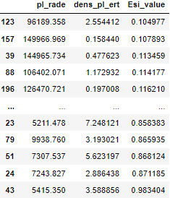
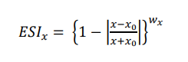
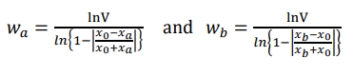
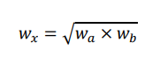
ESI value (Earth Similitude Index)
x is a planetary property
xo is a terrestrial reference
wx is a weight exponent
taking the geometric mean of these two limits.
Schulze-Makuch, et aL (2011). A Two-Tiered Approach to Assessing the Habitability of Exoplanets. Astrobiology, 11(10), 1041–1052. doi:10.1089/ast.2010.0592

Slide 10
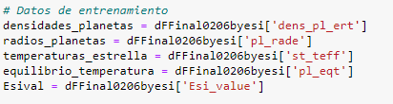
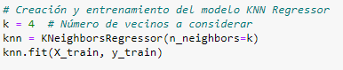
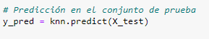
K-NeighborsRegressor

Slide 11
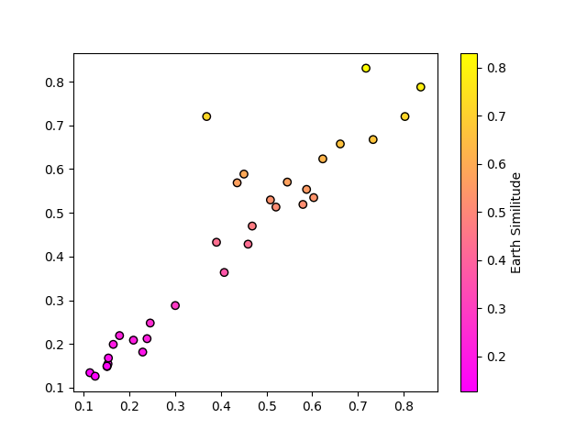
TEST DATA

Slide 12
SOLAR SYSTEM COMPARISON
 | pl_rade | dens_pl_ert | st_teff | pl_eqt | pl_name | Prediction KNR
0 | 6046.0790 | 5.239459 | 5773 | 226 | Venus | 0.80
1 | 3389.3720 | 3.933038 | 5772 | 210 | Mars | 0.83
2 | 69910.8943 | 1.329949 | 5774 | 110 | Jupiter | 0.20
3 | 58231.5771 | 0.699770 | 5777 | 63 | saturno | 0.24
4 | 25361.6768 | 19.049723 | 5778 | 64 | Uranus | 0.44
5 | 24617.5440 | 1.639776 | 5780 | 51 | Neptuno | 0.44

Slide 13
Testing the train set
HD 21749 c -- 0.83
GJ 367 b -- 0.83
TOI-270 b -- 0.81
HD 23472 d -- 0.83
HD 23472 e -- 0.84
L 98-59 b -- 0.83

Slide 14
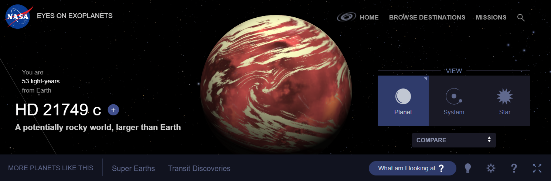
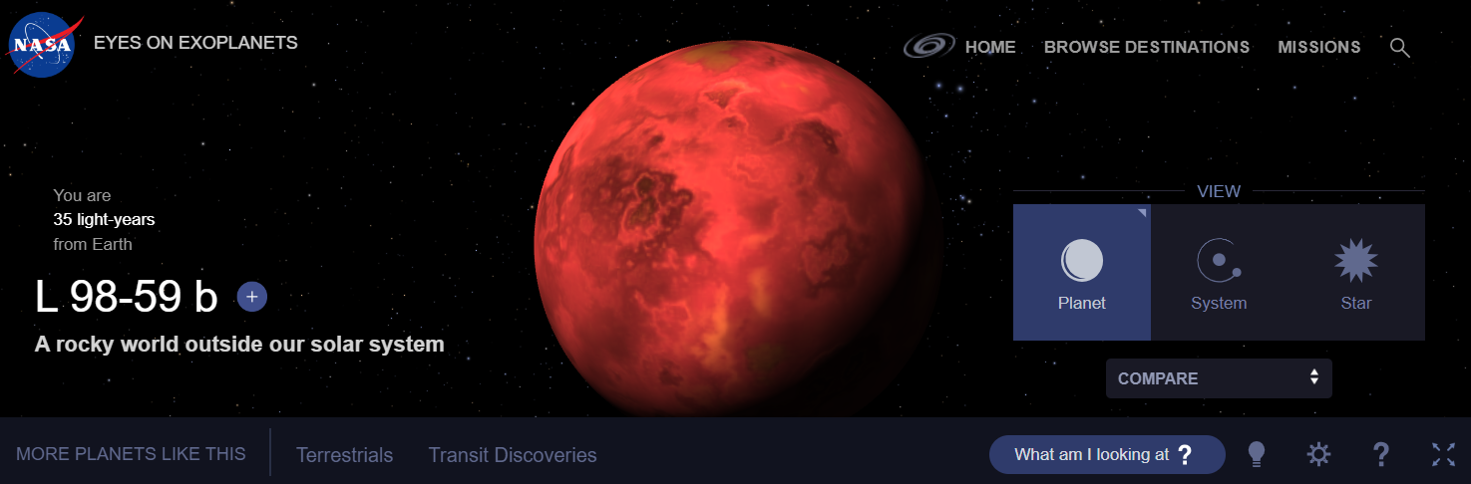

Slide 15
Conclusion
The model is robust enough to make accurate predictions regarding similarity to Earth.
Applying a machine learning model is not a trivial task, and it is necessary to conduct utility tests to decide which methods to use based on the problem or objective.
Based on the acquired knowledge, it is possible to carry out data analysis with enough value to determine if a planet is similar to Earth, according to the variables considered in the study.

Slide 16
References
Jagadeesh, M. K. (2017). Earth Similarity Index and Habitability Studies of Exoplanets (Master's thesis). Christ University, Bengaluru, India.
Schulze-Makuch, D., Méndez, A., Fairen, A. G., von Paris, P., Turse, C., Boyer, G., Davila, A. F., António, M. R. S., Catling, D., & Irwin, L. N. (2011). A Two-Tiered Approach to Assessing the Habitability of Exoplanets. Astrobiology, 11(10), 1041-1052. doi: 10.1089/ast.2010.0592
Exoplanet Exploration: Planets Beyond our Solar System. (s. f.). Exoplanet Exploration: Planets Beyond our Solar System. https://exoplanets.nasa.gov/
Sarah R N McIntyre and others, A rocky exoplanet classification method and its application to calculating surface pressure and surface temperature, Monthly Notices of the Royal Astronomical Society, Volume 519, Issue 4, March 2023, Pages 6210–6221, https://doi.org/10.1093/mnras/stad095

